Slide 1
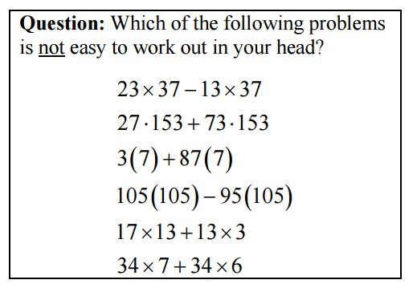
Number Talks………………..

Slide 2

Number Talks………………..
Can you find every number between 1-20 only using four 4s and any operation?

Slide 3
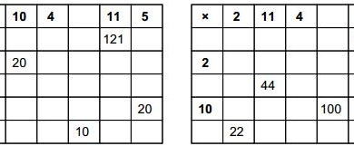
Number Talks………………..
https://mathsbot.com/starters/multiplicationGrids

Slide 4
Number Talks………………..

Slide 5
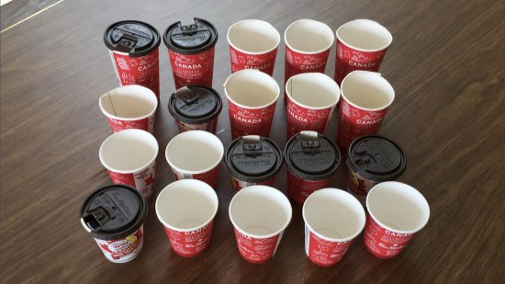
Number Talks………………..

Slide 6
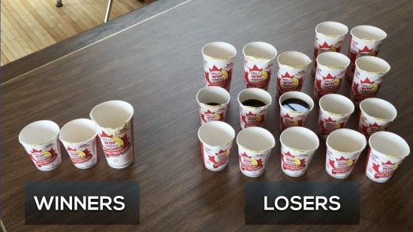
Number Talks………………..

Slide 7
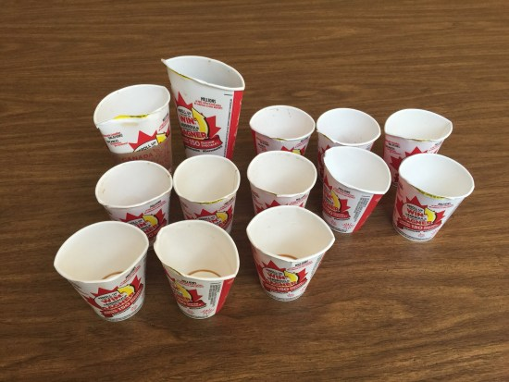
Number Talks………………..

Slide 8
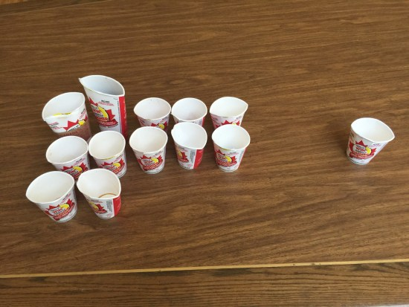
Number Talks………………..

Slide 9
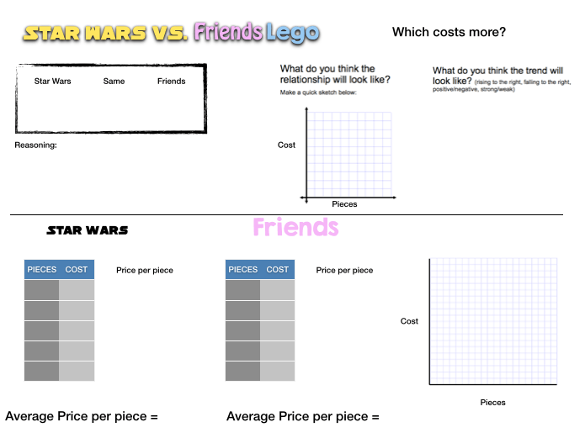
Number Talks………………..
http://mrorr-isageek.com/is-lego-gender-biased/
http://www.toysrus.ca/family/index.jsp?categoryId=12459284

Slide 10
Number Talks………………..
Why do you think that?
Why do you think that you cannot write number sentences that look like that?
Do you agree or disagree with Student A? Why?
Thank you for sharing.
Please let me know if I’m not rephrasing you correctly. (I'm only rephrasing when I have trouble hearing the student.)
I want to make sure we’re writing down your thinking correctly, please slow down and tell us more about this step.
I’m not worried about the correct answer right now, I’m just interested in how you thought about the problem.
Your sharing of how you arrived at the incorrect answer is really important — I think we learn a lot from our mistakes, and as you can see, you weren't the only one who thought about it that way.
Did you change your mind or question your strategy after you talk with your neighbor?
Who did the problem differently than the 3 people whom I called on to share?
I really appreciate how you questioned [and responded to] _____’s sharing.
I know it’s kind of tough to articulate your thinking. That’s okay. Take your time.
Math teachers sometimes get it wrong too

Slide 11
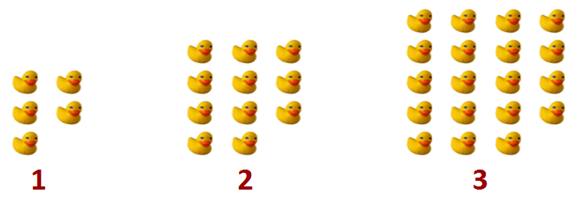
Number Talks………………..

Slide 12
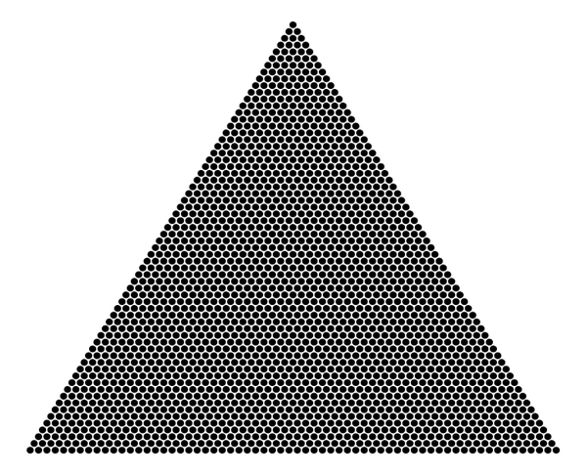
Number Talks………………..

Slide 13
Number Talks………………..
84 – 59
42 – 19
50 – 28

Slide 14
Number Talks………………..
3.63 – 1.95
3.6 – 1.95
3.63 – 1.9

Slide 15
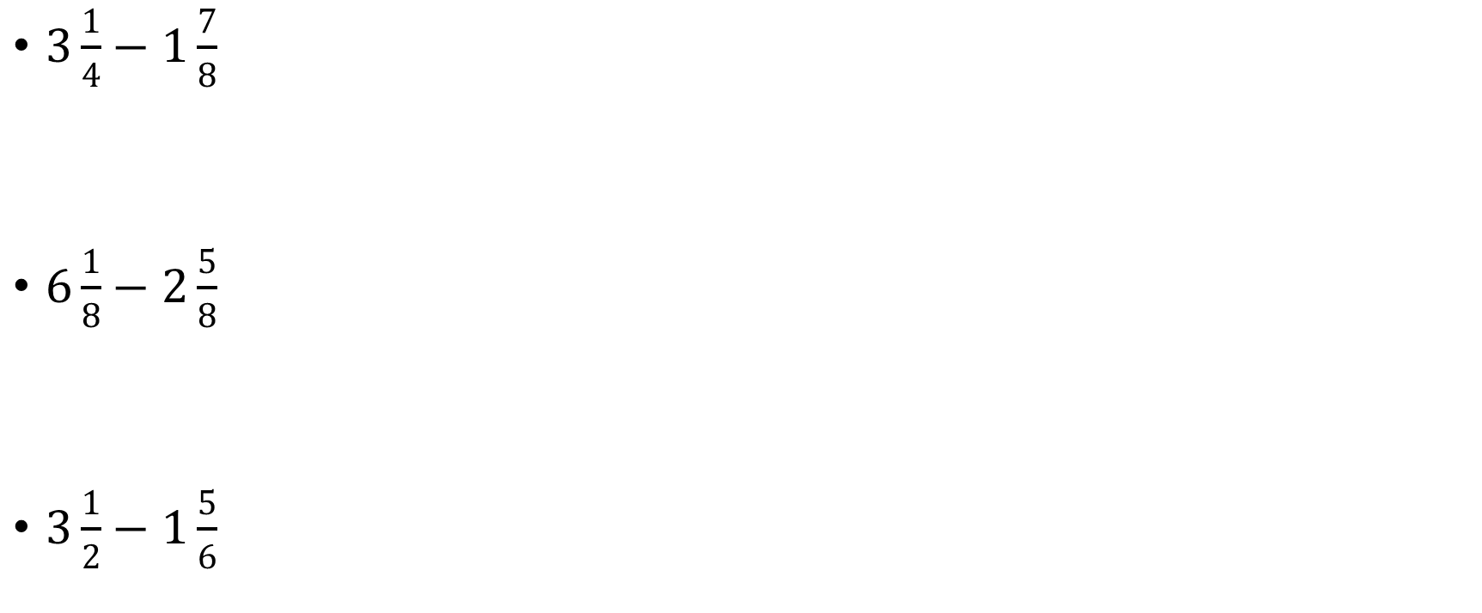
Number Talks………………..
$3\frac{1}{4}−1\frac{7}{8}$
$6\frac{1}{8}−2\frac{5}{8}$
$3\frac{1}{2}−1\frac{5}{6}$

Slide 16
Number Talks………………..
It takes a machine 12 minutes to fill 200 bottles of soda. At this rate, how many minutes will it take the machine to fill 500 bottles of soda?

Slide 17
Number Talks………………..
6/8 ÷ ¼
2/3 ÷ 1.6
48 ÷ 1.2
2.4 ÷ 1/5
16,000 ÷ 2,000
245 ÷ 7
829 ÷ 9
1 1/2 ÷ ¼
0.45 ÷ 0.3

Slide 18
Number Talks………………..
1 – 3/5
1/4 + ½
4/6 – 1/3
3/4 + 1/2
1 3/4 + ½
1/4 + 2/4
4/6 – 1/3
3/12 + ¼
5/8 – 1/2

Slide 19
Number Talks………………..
-98 + (-97)
- 27 - (-63)
100 + (- 49)

Slide 20
Number Talks………………..
Greater than, less than, or equal to? 89 + 15 􀂆􀀃85 + 19
Greater than, less than, or equal to? 89 x 15 􀂆􀀃85 x 19
Greater than, less than, or equal to? 16 x 38 􀂆􀀃18 x 36
Greater than, less than, or equal to? 32 x 18 􀂆􀀃38 x 12

Slide 21
Number Talks………………..
156 - 38
62 - 33
100 - 49
750 + 250
372 + 98
59 + 36
864 – 500
370 + 99
855-56
104 – 39
87 + 49
58 – 39
91 – 53
37 + 86
499 + 76
17 x 8
25 x 6
450 ÷ 45
20 x 4 x 2
15 x 30
16 x 5

Slide 22
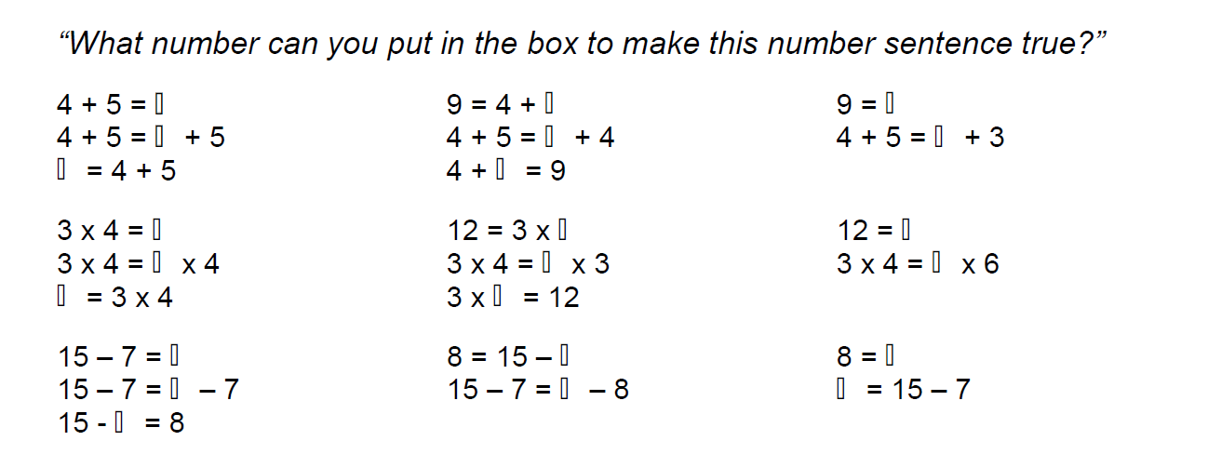
Number Talks………………..

Slide 23
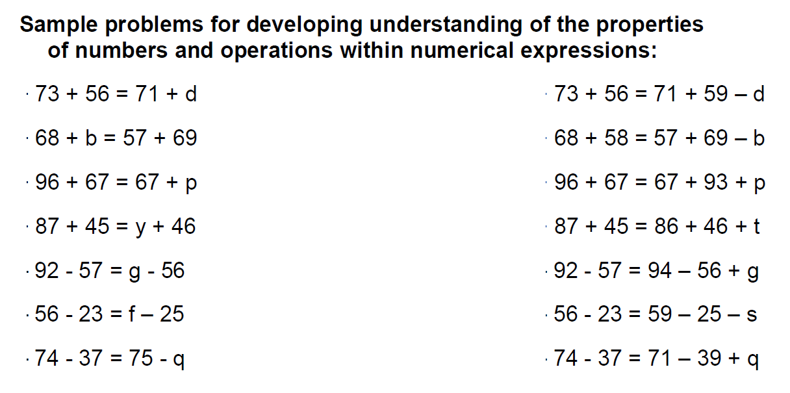
Number Talks………………..

Slide 24
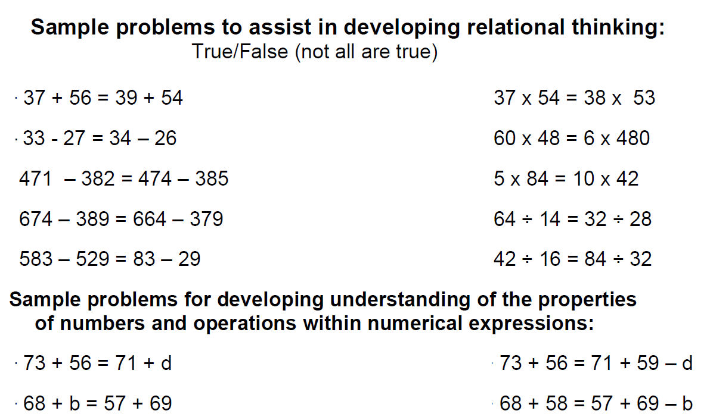
Number Talks………………..

Slide 25
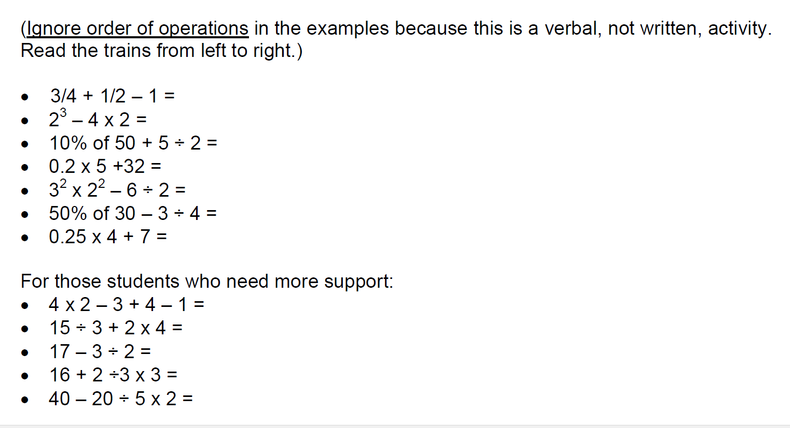
Number Talks………………..

Slide 26
Number Talks………………..
Which two are closest? How do you know?
How did you think about the differences between the numbers?
How do you know [a number] is larger/smaller than [another number]?
Which is closer to [a number]? By how much? (e.g., Which of the 3 numbers is closest to 1.8?)
Name 3 numbers between [one of the numbers] and [one of the other numbers]. (e.g., Name 3 numbers between 2.3 and 3.2.)
How do you know [a number] is between the 2 numbers we named? Which number is it
closer to? How do you know?
What number is 1 larger than [one of the numbers]?
What number is [say a decimal amount] smaller than [one of the numbers]? (e.g., What number is 0.4 less than 3.2?
Name a number that is smaller than all three numbers.
Name 2 numbers that make these seem large.
When you saw [a number], how did you picture that amount in your head?

Slide 27
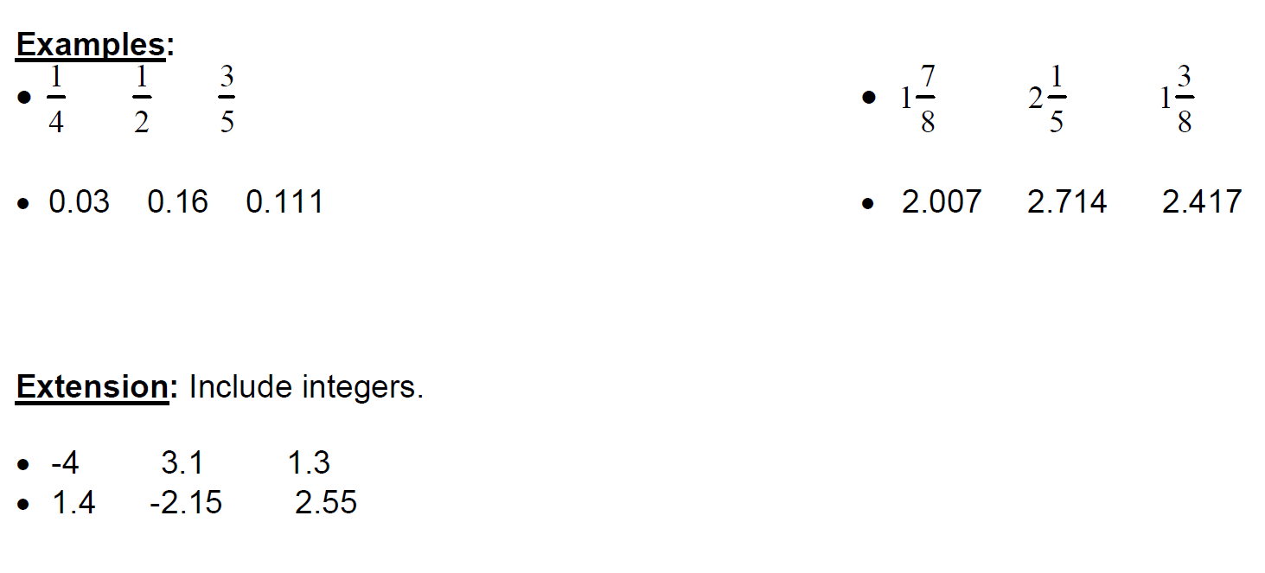
Number Talks………………..

Slide 28
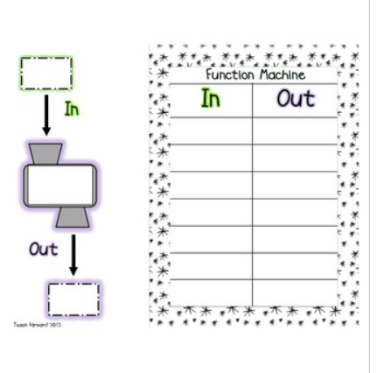
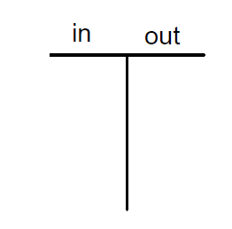
Number Talks………………..

Slide 29
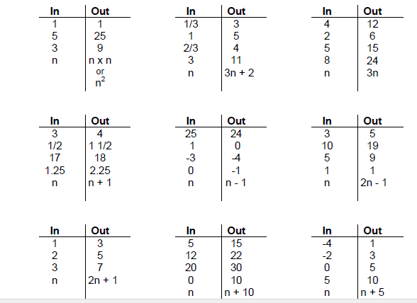
Number Talks………………..

Slide 30
Number Talks………………..
10% of 50
20% of 250
40% of 350
90% of 900

Slide 31
Number Talks………………..
Rearrange 2 segments to build a larger number

Slide 32
Number Talks……………….

Slide 33
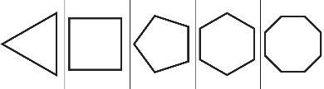
Fraction Talks……………….

Slide 34
Fraction Talks……………….

Slide 35

https://www.youtube.com/watch?v=Tpyg9Q9AjiQ&feature=youtu.be

Slide 36
Would You Rather……….
Would you rather always be 10 minutes late or always be 20 minutes early?
Would you rather lose all of your money and valuables or all of the pictures you have ever taken?
Would you rather be able to see 10 minutes into your own future or 10 minutes into the future of anyone but yourself?
Would you rather go to jail for 4 years for something you didn’t do or get away with something horrible you did but always live in fear of being caught?
Would you rather be completely invisible for one day or be able to fly for one day?

Slide 37
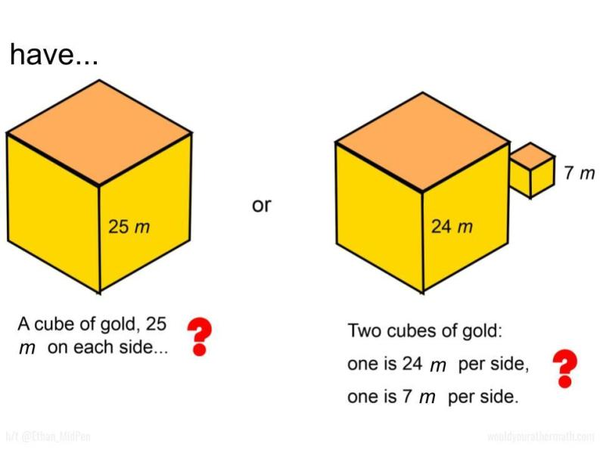
Would You Rather……….

Slide 38
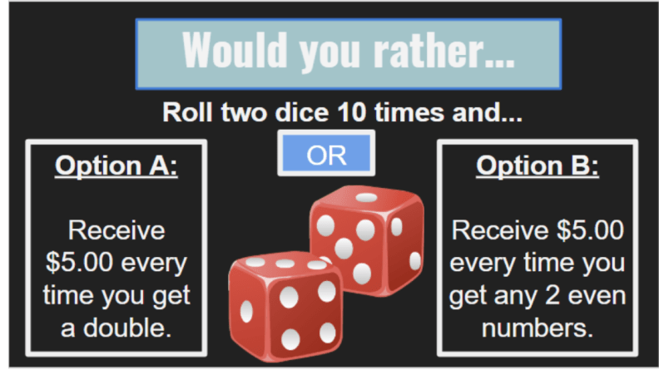
Would You Rather……….

Slide 39
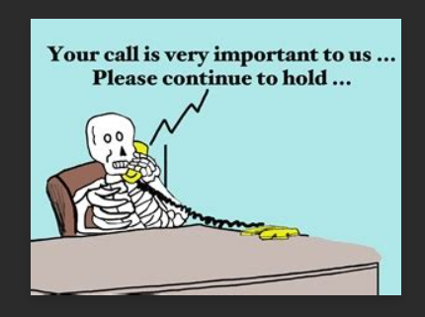
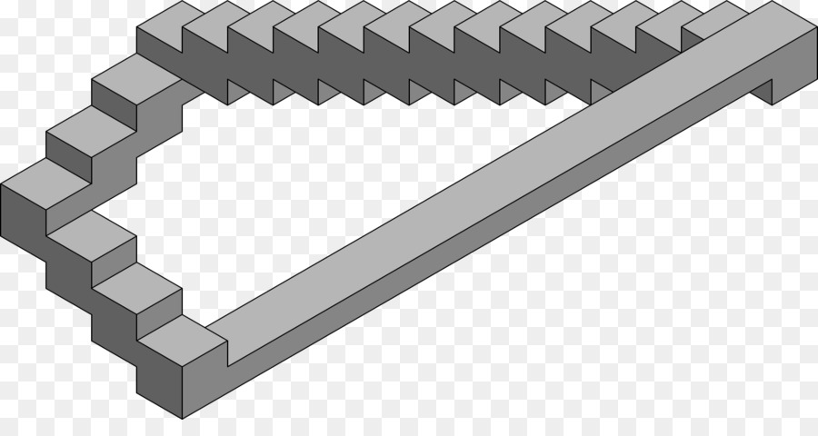
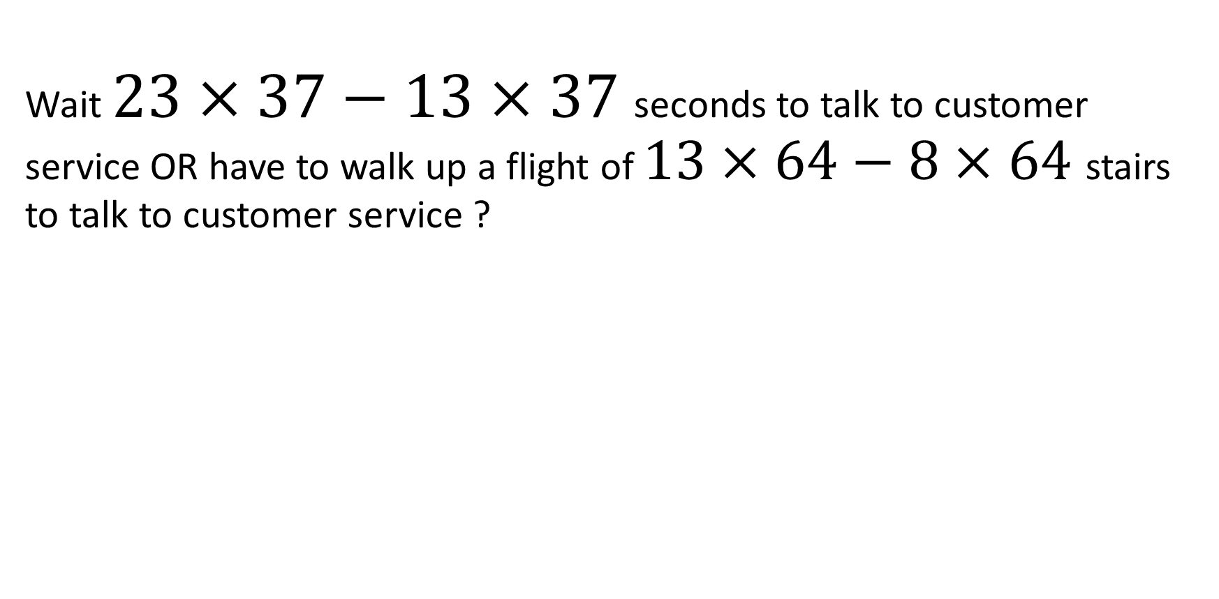
Would You Rather……….
Wait $23×37−13×37$seconds to talk to customer service OR have to walk up a flight of $13×64−8×64$ stairs to talk to customer service ?

Slide 40
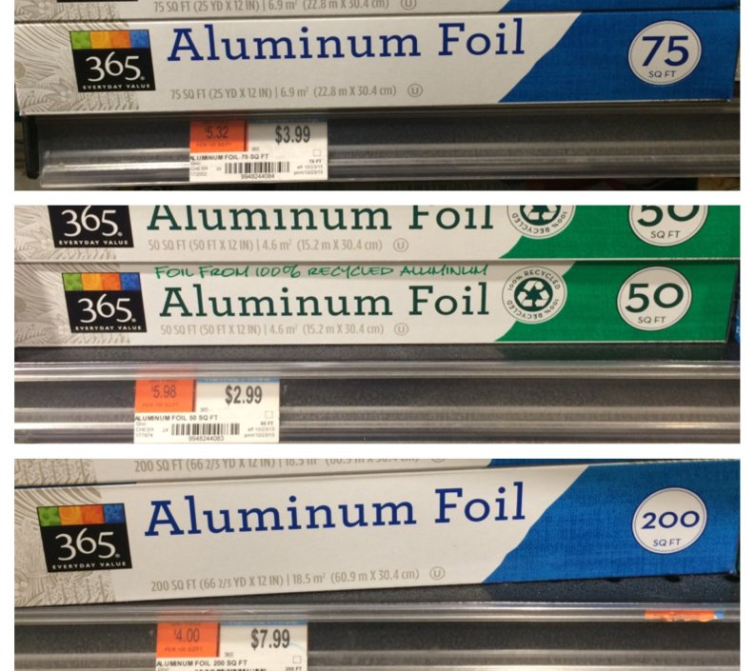
Would You Rather……….

Slide 41
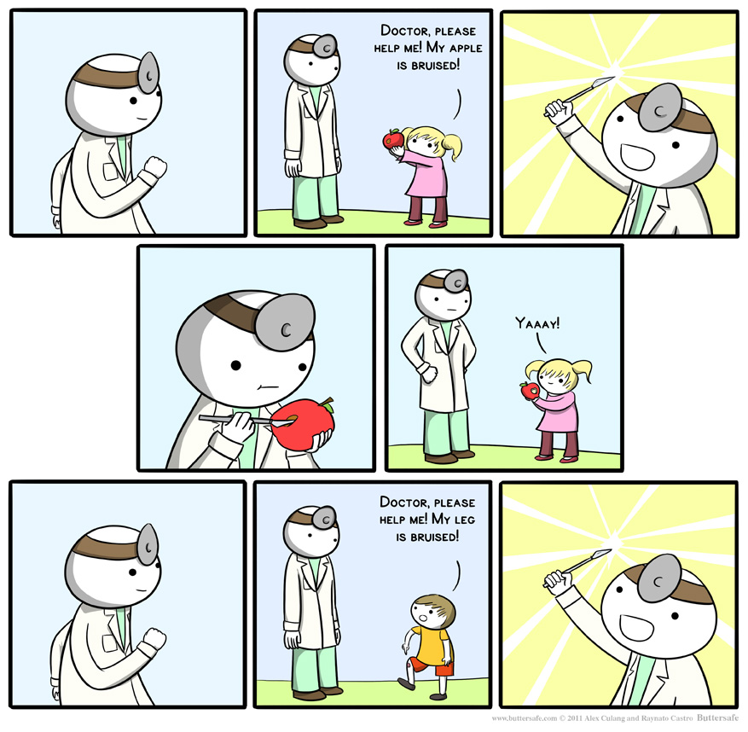
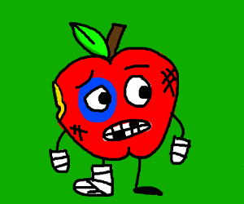
Would You Rather……….
Have 20% of 250 apples with bruises or 40% of 150 with bruises?

Slide 42
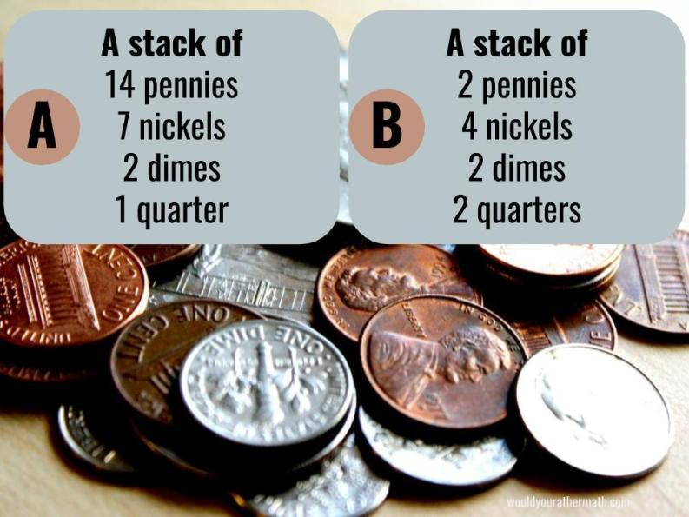
Would You Rather……….

Slide 43
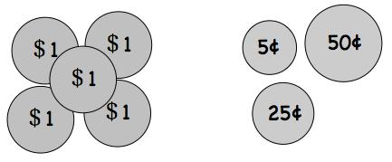
Would You Rather……….
Have 10% of 5$ or 75% of 80 cents

Slide 44

Would You Rather……….
Be given 60% of 2 pizzas or 26% of 5 pizzas

Slide 45
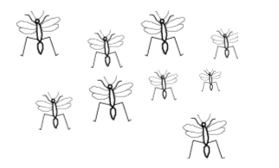
Would You Rather……….
Be bitten by 15% of 120 mosquitoes or 8% of 250 mosquitoes?

Slide 46
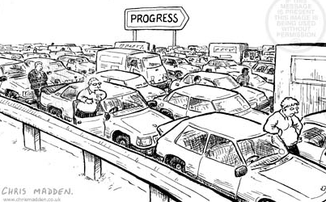
Would You Rather……….
Sit in a traffic jam for 33% of 2 hours or 44% of 1hr 40mins?

Slide 47
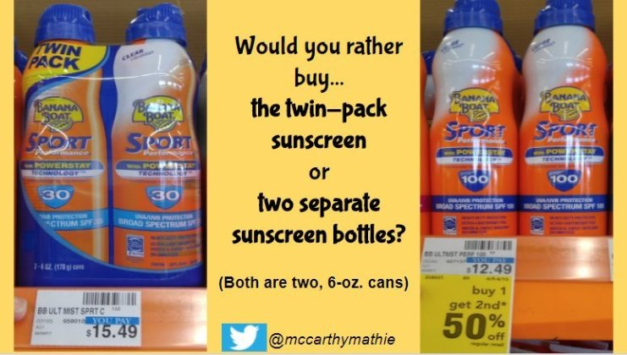
Would You Rather……….

Slide 48
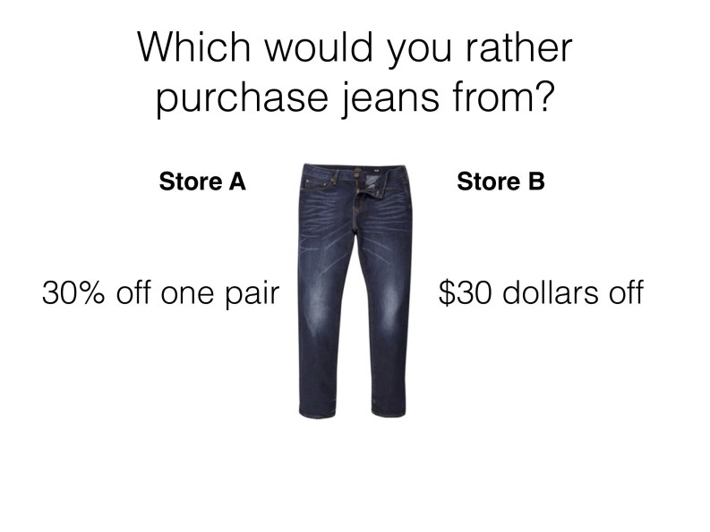
Would You Rather……….

Slide 49
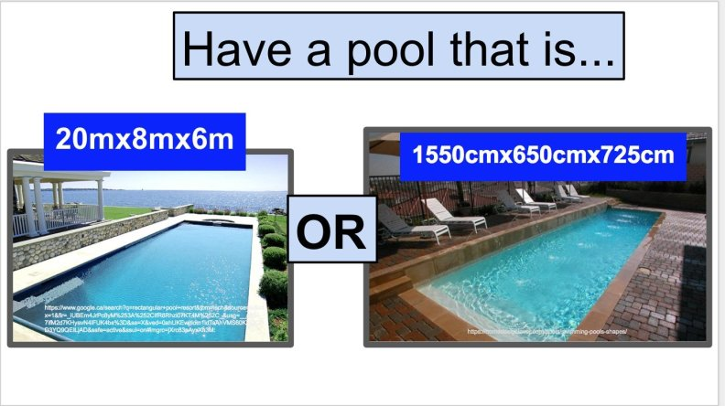
Would You Rather……….

Slide 50

Would You Rather……….

Slide 51
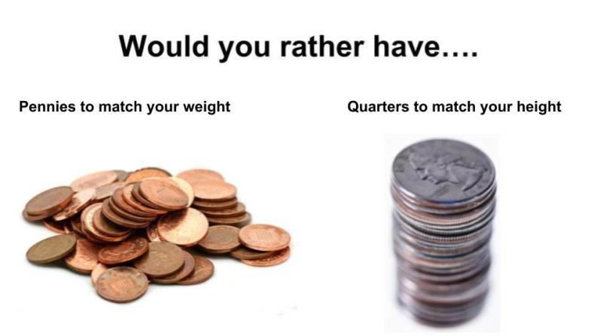
Would You Rather……….

Slide 52
Would You Rather……….

Slide 53
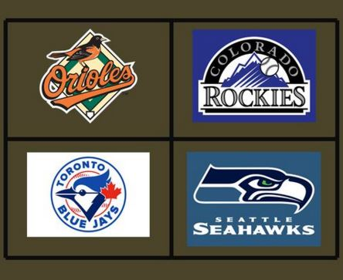
Which one of these is not like the others……..
https://www.youtube.com/watch?v=rsRjQDrDnY8
https://www.youtube.com/watch?v=MdHvH2noS8U

Slide 54
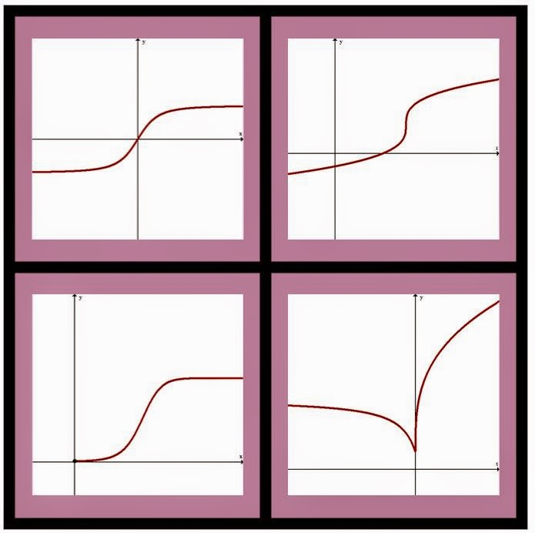
Which one of these is not like the others…………

Slide 55

Which one of these is not like the others……..

Slide 56
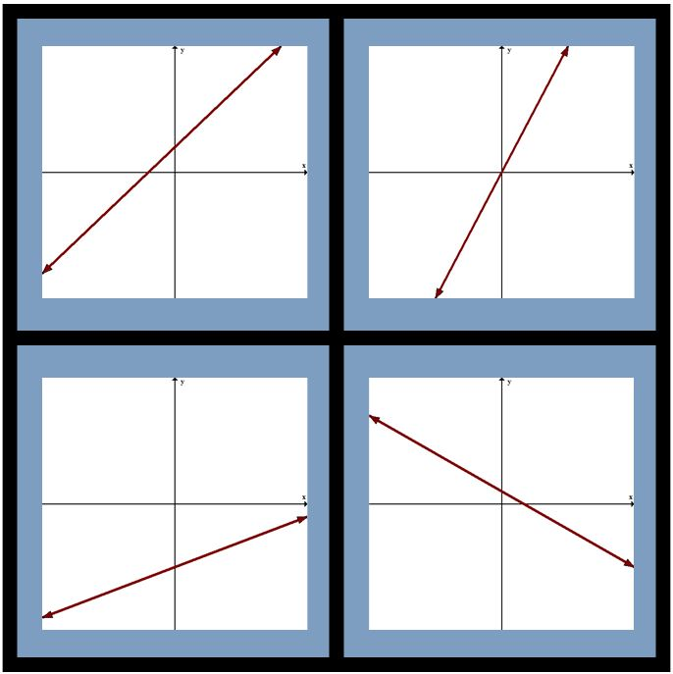
Which one of these is not like the others……..

Slide 57
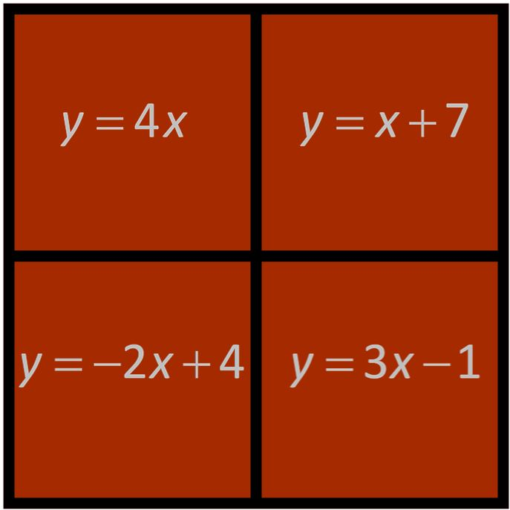
Which one of these is not like the others……..

Slide 58
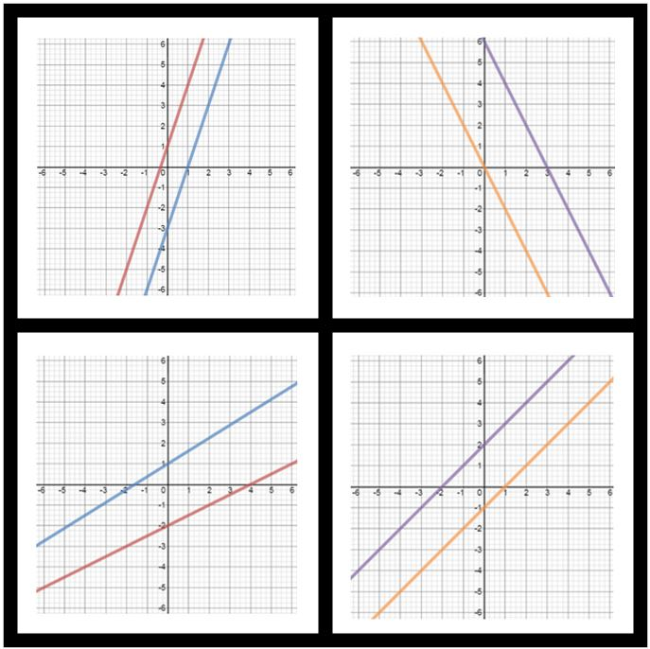
Which one of these is not like the others……..

Slide 59
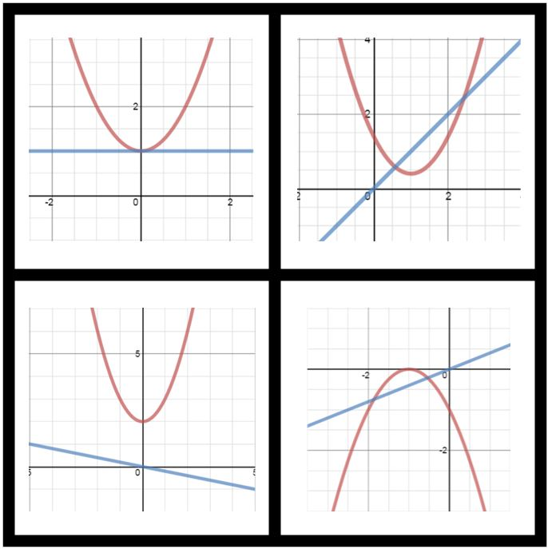
Which one of these is not like the others……..

Slide 60
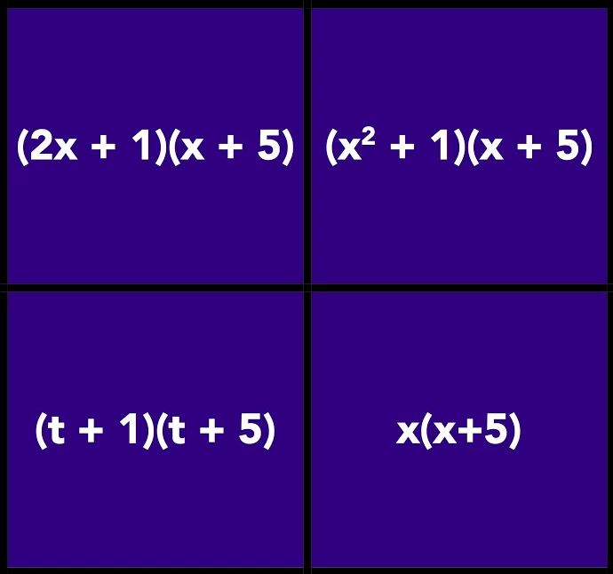
Which one of these is not like the others……..

Slide 61
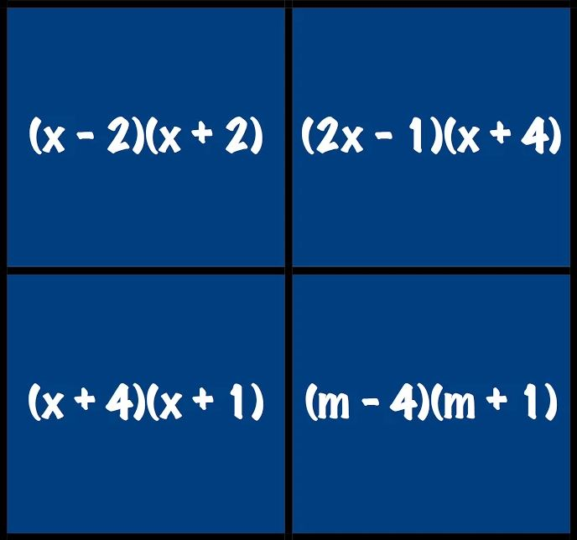
Which one of these is not like the others……..

Slide 62
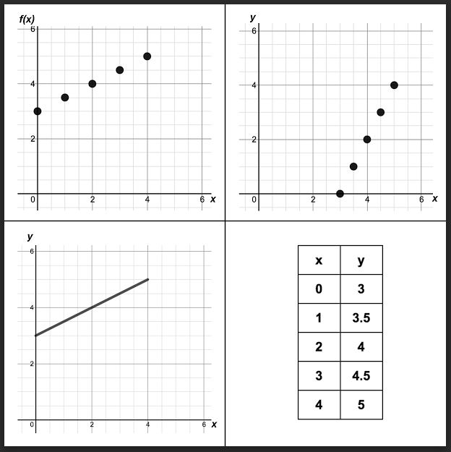
Which one of these is not like the others……..

Slide 63
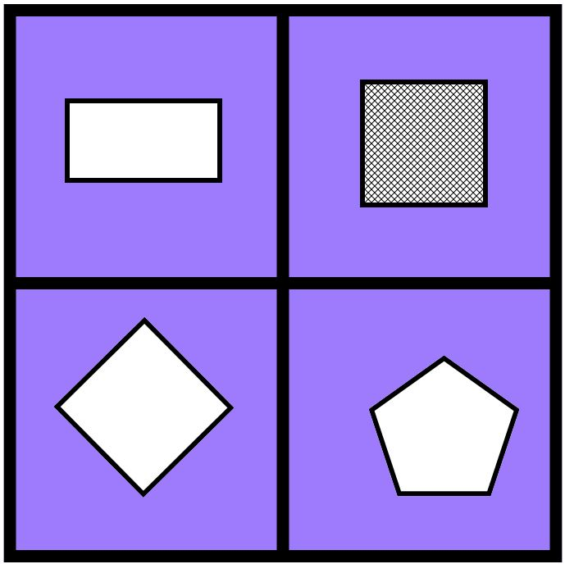
Which one of these is not like the others……..

Slide 64
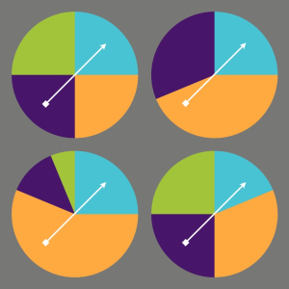
Which one of these is not like the others……..

Slide 65
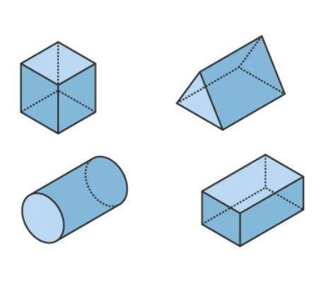
Which one of these is not like the others……..

Slide 66
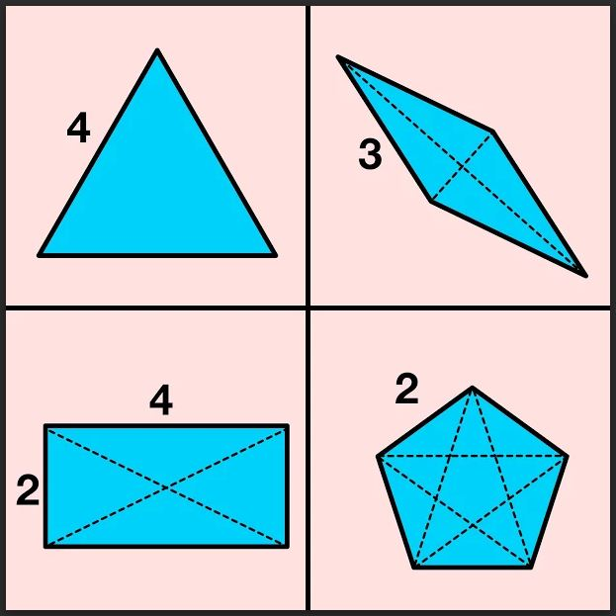
Which one of these is not like the others……..

Slide 67
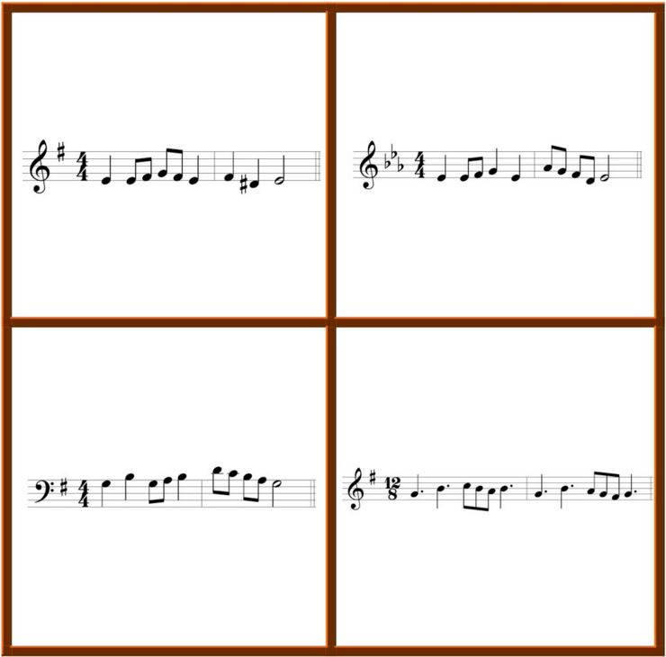
Which one of these is not like the others……..

Slide 68
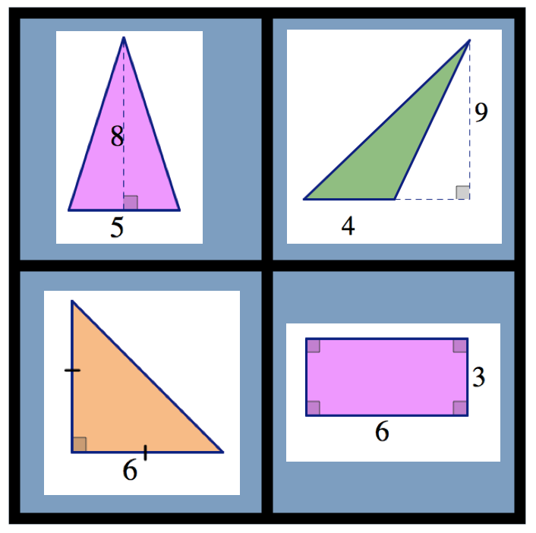
Which one of these is not like the others……..

Slide 69

Which one of these is not like the others……..

Slide 70

Which one of these is not like the others……..

Slide 71

Which one of these is not like the others……..

Slide 72

Which one of these is not like the others……..

Slide 73

Which one of these is not like the others……..

Slide 74

Which one of these is not like the others……..

Slide 75

Which one of these is not like the others……..

Slide 76

Which one of these is not like the others……..

Slide 77

Which one of these is not like the others……..

Slide 78

Which one of these is not like the others……..

Slide 79

Which one of these is not like the others……..

Slide 80

Which one of these is not like the others……..

Slide 81

By my GUESS…..
What is your lowball guess
What is your highball guess
Meet me in the middle?

Slide 82

By my GUESS…..

Slide 83

By my GUESS…..

Slide 84

By my GUESS…..

Slide 85

By my GUESS…..
Marilyne is 94 cm
How tall is………..

Slide 86

By my GUESS…..

Slide 87

By my GUESS…..
If (x,y) is (8, 8) what would the opposite point be that is located on the circle?
If the arc from the x-axis to point (x,y) is 12cm, what is the length of the arc from (x,y) to the –r on the x-axis?

Slide 88

By my GUESS…..
If one of the points is located at (12,25), where are the other points?

Slide 89

By my GUESS…..
What is the shaded area under the red line?

Slide 90

By my GUESS…..
A and C are both 10. What is the area showing that needs to be covered in siding?

Slide 91

By my GUESS…..
How many people are over 35?
How many people go to school?
How many people have cell phones?

Slide 92
By my GUESS…..

Slide 93
Number Strings
a set of related math problems, crafted to support students to construct big ideas about mathematics and build their own strategies
A Number String is a way to help develop strategies whereas a Number Talk is to talk about the different strategies students have for that one problem, how they connect together, how they’re alike, and how they are different.

Slide 94
Number Strings
At the core sampling site, I noticed that there was a geologist with a corer that was half in the water and half out of the water. The part that I could see in the air was 2 feet long. How long was the corer?
I got to the core sampling site, I noticed that there was a corer that was ⅓ in the air, 1/3 in the water, and the rest was in the mud. I was told that the part in the mud was 2 1/3 ft long. How long was the corer?
The best core sample was about to happen. I could tell by the corer they were using. The corer had 3 ft out of the water. I was told that 1/2 of the corer was in the water and ⅓ of the corer was in the mud. How long was the pole?

Slide 95

Number Strings

Slide 96




Number Strings……………….Prime climb

Slide 97
Number Strings
32 ÷ 4
320 ÷ 40
3200 ÷ 400
3.2 ÷ .4
5.6 ÷ .8

Slide 98
Number Strings
13.2 ÷ 1.1
3.6 ÷ 1.8
7.2 ÷ 4.5
245 ÷ 3.5
32 ÷ .25
3600 ÷ 1.4
108 ÷ 2.4

Slide 99
Number Strings
TELL a STORY
Draw number and teacher labels 0 miles on left side and 24 miles on right side
1/2 of 24 (“tell the story, we stopped half way through the bike ride to get ice cream”)
1/4 of 24 (“Oh, I forgot, we also stopped one fourth of the way to drink some water”)
3/4 of 24
1/8 of 24
3/8 of 24
7/8 of 24
5/8 of 24

Slide 100
Number Strings
2n = 20
2n + 4 = 20
2n + 10 = 20
2n + 1 = 20
2n - 2 = 20
2n - 5 = 20

Slide 101
Number Strings
49 + 28
7x7 + 4x7
77 + 63
11x7 + 9x7
56 + 24
7x8 + 3x8
88 + 72
11a + 9a

Slide 102
Number Strings
x(x + 4) = 5
x(x – 1) = 12
x(x – 2) – 8 = 0
x² + 2x = 15

